Slide 1
CSE7302 - INTERNSHIP Review-4 Presentation MLFF
Student Details
Name | Hemanth Nagaraj
Roll No | 20221CSE0527
Section | 8CSE09
Under the Supervision of,
Dr. Sudha P
Associate Professor
Presidency School of CSE
Presidency University
Name of the Program: Computer Science and Engineering
Name of the HoD: Dr. Asif Mohammad
Name of the Program Internship Coordinator: Dr. Balakrishna
Name of the School Internship Coordinator: Dr. Md Ziaur Rahman

Slide 2
Content
About Company or Organization
Working domain or the technology
About your team and reporting Manager
Challenges Faced in Internship
Objectives of the work
Literature Review
Internship Work

Slide 3
About Company or Organization
ViaPlus is a global mobility technology company operating in the Intelligent Transportation Systems (ITS) industry. The organization provides advanced platforms that help transportation agencies and roadway operators manage tolling, traffic movement, and mobility services more efficiently.
The company specializes in building data-driven transportation solutions that support modern, automated road infrastructure. Its systems enable seamless vehicle movement while ensuring accurate revenue collection and enforcement.
Core Areas of Work
Electronic Toll Collection (ETC) systems
Toll enforcement and violation processing
Road user charging solutions
EV charging and smart mobility integration
End-to-end mobility ecosystem management
ViaPlus plays a significant role in transforming traditional toll-based highways into smart, connected, and free-flow transportation networks using cloud platforms, sensor data, and intelligent back-office processing systems.

Slide 4
Working domain or the technology
During my internship, I worked in the Intelligent Transportation Systems (ITS) domain, mainly focusing on the Mobility Back Office (MBO) and toll transaction processing. The system converts raw roadside sensor data into accurate, billable toll records.
Vehicle data is captured using RFID readers and ANPR cameras. This information is processed in the back-office system where vehicles are verified, toll rules are applied, and financial transactions are generated.
The technology stack includes MBO architecture, Computer Vision (AI/ML), IoT roadside devices, and cloud infrastructure for scalable and reliable operations.
The platform supports Multi-Lane Free Flow (MLFF) tolling, allowing vehicles to pass without stopping, which reduces congestion and improves efficiency. I also contributed to backend monitoring dashboards using C# and .NET to track transactions and system performance.

Slide 5
Challenges Faced in Internship
During my internship, I encountered several practical challenges that helped me grow technically and professionally.
One major challenge was adapting to a new technology stack and domain. Moving from academic projects to large-scale enterprise systems required understanding complex architectures and industry standards.
Another key challenge was working on financially sensitive tolling systems, where even a small error could affect real monetary transactions. This required writing highly reliable code with proper validation, exception handling, and detailed logging.
I also faced difficulties in setting up and understanding the development environment, which included databases, APIs, and multiple interconnected services. Learning how these components interact was essential before contributing effectively.
These challenges improved my problem-solving skills and gave me valuable exposure to real-world software development practices.

Slide 6
Objectives of the work
The primary objective of my internship was to gain practical exposure to the Intelligent Transportation Systems (ITS) domain and understand how modern tolling solutions operate in real-world environments.
I aimed to learn the end-to-end lifecycle of an Electronic Toll Collection (ETC) transaction, starting from vehicle detection using roadside sensors to the generation of validated financial records in the back-office system.
Another key objective was to adapt to a professional Agile/Scrum development environment, actively participating in sprint planning, daily stand-ups, and review meetings to understand collaborative software development practices.
Additionally, I focused on enhancing my technical skills by contributing to backend modules and developing monitoring dashboards using C# and .NET, which help track system performance and transaction data.

Slide 7
Advantages of Proposed System/Work
The proposed system offers several improvements over traditional toll collection methods by combining automation, real-time data processing, and intelligent monitoring.
One major advantage is reduced traffic congestion, as vehicles can pass through toll zones without stopping under the Multi-Lane Free Flow (MLFF) model. This leads to smoother traffic movement and shorter travel times.
The system also ensures high transaction accuracy by using RFID and ANPR technologies along with strong back-office validation processes. This minimizes human errors and improves financial reliability.
Another benefit is scalability and reliability, supported by cloud-based infrastructure that can handle large volumes of real-time vehicle data efficiently.
The inclusion of monitoring dashboards developed using C# and .NET provides operational visibility, allowing teams to track system performance, detect issues quickly, and maintain uninterrupted tolling services.
Overall, the proposed work contributes to a faster, smarter, and more efficient tolling ecosystem that enhances both user convenience and operational effectiveness

Slide 8
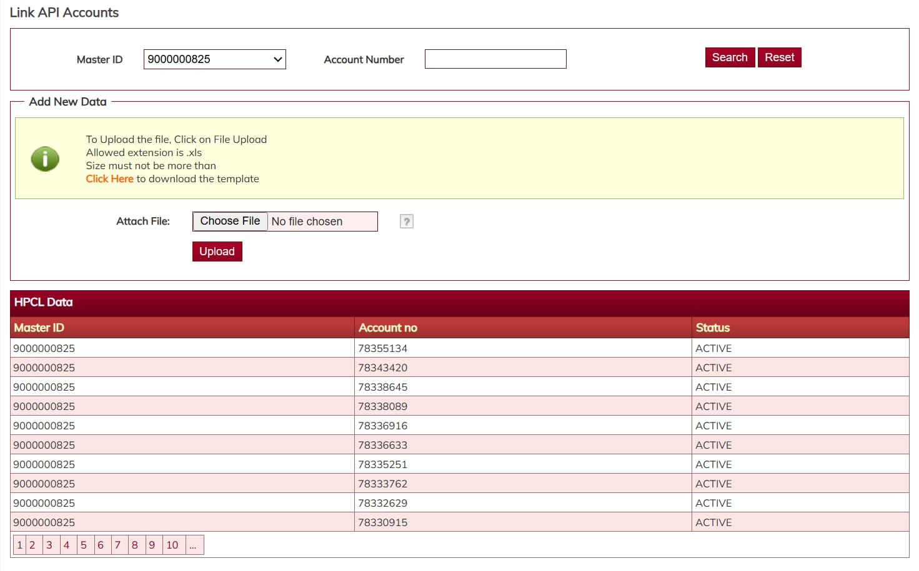
Internship Work

Slide 9
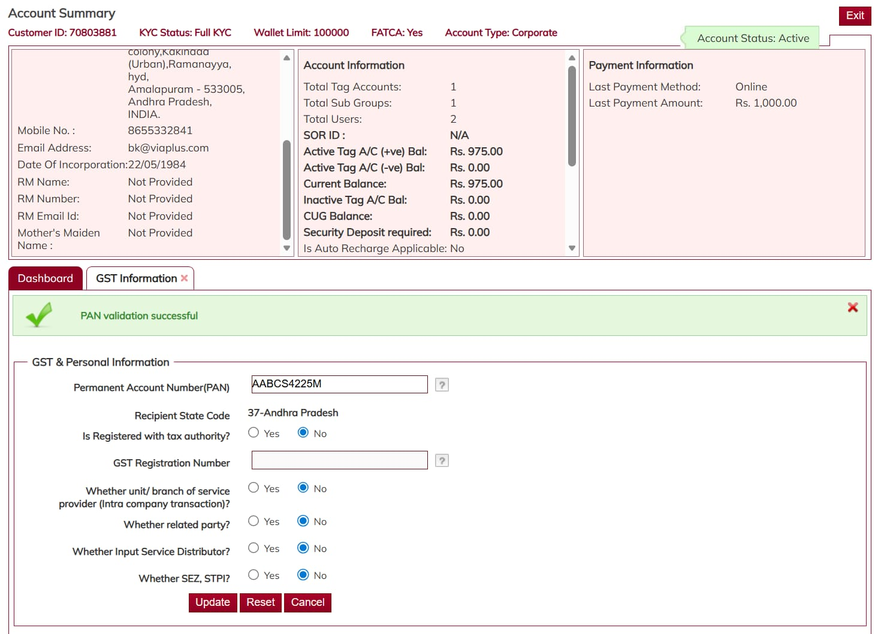
Internship Work

Slide 10
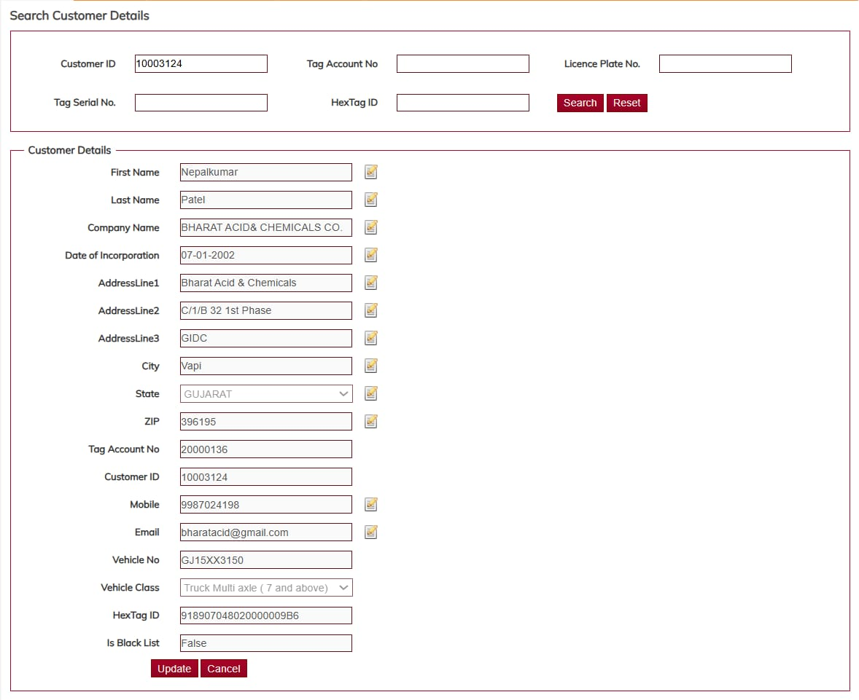
Internship Work

Slide 11
Q&A

Slide 12
Thank you !!

